Slide 1
Simulation and Modeling
CSE4131_CSE4132

Slide 2
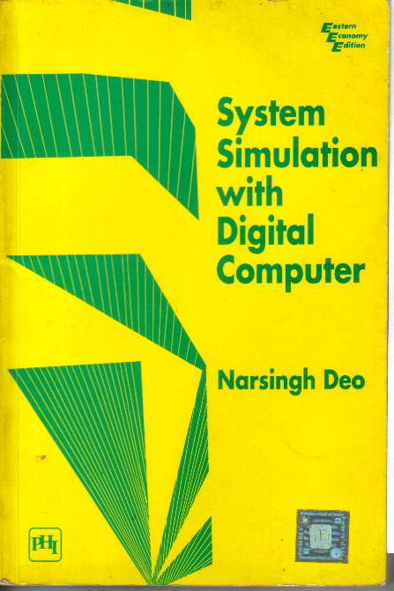
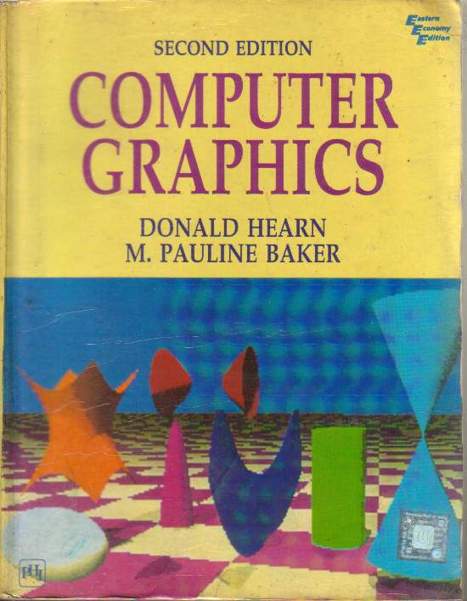
Recommended Books
SYSTEM SIMULATION WITH DIGITAL COMPUTER
- By Narsingh Deo
COMPUTER GRAPHICS
- By Donald Hearn & M. Pauline Baker

Slide 3
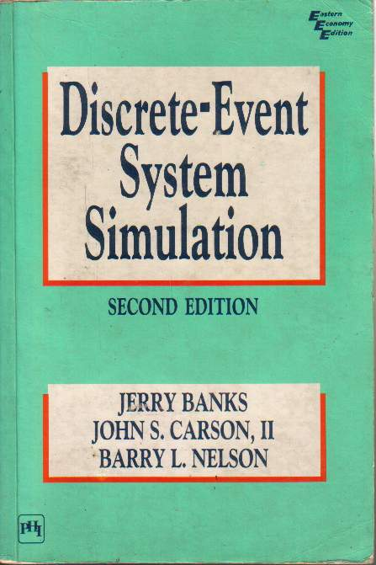
Recommended Books
DISCRETE-EVENT SYSTEM SIMULATION
Jerry Banks, John S. Carson, Barry L. Nelson
Publisher: Prentice- Hall

Slide 4
Practical
C/C++ (Code Block IDE)
SimScript or ModelSim

Slide 5

A Video Introduction of SaM

Slide 6
Simulation
What is simulation? (Formal Definition)
Simulation → অনুকরন করা
A simulation is the imitation (নকল করা) of the operation of a real world process or system over time.
Can be done:
by hand or on a computer

Slide 7
Types of simulation
Live - A simulation involving real people operating real systems. Military training events using real equipment are live simulations. They are considered simulations because they are not conducted against a live enemy.
Virtual - A simulation involving real people operating simulated systems. Virtual simulations inject a Human-in-the-Loop into a central role by exercising motor control skills (e.g., flying jet or tank simulator), decision making skills (e.g., committing fire control resources to action), or communication skills (e.g., as members of a C4I team).

Slide 8
Constructive - A simulation involving simulated people operating simulated systems. Real people stimulate (make inputs to) such simulations, but are not involved in determining the outcomes. A constructive simulation is a computer program
For example, a military user may input data instructing a unit to move and to engage an enemy target

Slide 9
Definition of System (2013)
A system is defined as a group of objects that are joined together in some regular interaction or interdependence toward the accomplishment of some purpose.
A system is often affected by changes occurring outside the system.
Such changes are said to occur in the system environment
… it is necessary to decide on the boundary between the system and its environment

Slide 10
Simulation
Simulation involves
Generation of an artificial history of a system + Observation of that artificial history
=➢Conclusion …operating characteristics of the real system.

Slide 11
Simulation … Appropriate Tool (2012)
SIMULATION CAN BE USED FOR THE FOLLOWING PURPOSES:
Simulation enables the study of internal interaction of a subsystem or of a complex system
Informational (say false fire alarm) + organizational (say removing supervisor)+ environmental changes(say introducing lunch) can be simulated and the effect of these alternations on the model’s behavior can be observed.
to gain knowledge about improvement of system
Finding important input parameters with changing simulation inputs

Slide 12
When Simulation … Appropriate Tool
Simulation can be used to experiment with new design and policies before implementation
Simulation can be used to verify analytic solutions.
Simulation can be used for training …without the cost disruption.
A plan can be visualized with animated simulation
The modern system (factory, wafer fabrication plant, service organization) is too complex that its internal interaction can be treated only by simulation

Slide 13
When Simulation Is Not Appropriate
When the problem can be solved by common sense.
When the problem can be solved analytically (logically).
If it is easier to perform direct experiments.
If cost exceed savings.
If resource or time are not available.
If system behavior is too complex.
Like human behavior

Slide 14
Advantages (2011)
New policies, operating procedures, decision rules, information flows, organizational procedures, and so on can be explored without disrupting ongoing operations of the real system.
New hardware designs, physical layouts, transportation systems, and so on, can be tested without committing resources for their acquisition.
Hypotheses about how or why certain phenomena (ঘটনা) occur can be tested for feasibility.
Time can be compressed or expanded allowing for a speedup or slowdown of the phenomena under investigation.

Slide 15
Advantages
Insight can be obtained about the interaction of variables.
Insight can be obtained about the importance of variables to the performance of the system.
Bottleneck analysis (?) can be performed indicating where work-in-process, information, materials, and so on are being excessively delayed.
A simulation study can help in understanding how the system operates rather than how individuals think the system operates.
What-if questions can be answered. This is particularly useful in the design of new systems.

Slide 16
Disadvantages
Model building requires special training.
Simulation results can be difficult to interpret.
Simulation modeling and analysis can be time consuming and expensive.
Simulation is used in sometime when an analytical solution is possible or even preferable.

Slide 17
Overcome the Limitations (2011)
Vendors of simulation software have been actively developing packages that contain models that need only input data for their operation.
Many simulation software vendors have developed output analysis capabilities within their packages for performing very thorough(সম্পূর্ণ) analysis.
Simulation can be performed faster today than yesterday, and even faster tomorrow.
Closed-form models are not able to analyze most of the complex systems that are encountered in practice.

Slide 18
Area of application (2011)
Manufacturing Systems
Aircraft, Automobile…
Semiconductor Manufacturing
Rapid manufacturing
Public systems
Health care –prediction of pharmaceutical costs and outcome
Military – army officer professional development
Natural resource – solid waste management system
Transportation System
i.e. cargo transport system
Container port operations

Slide 19
Area of application
Construction systems
i.e. cable-stayed bridge…
Restaurant and entertainment system
Quick service restaurant traffic analysis
Determination of labor requirements
Business process reengineering
Business process modeling and analysis tools
Integrating business process reengineering with image based work flow.
Food processing
Fishing boat operations in fish processing industries
Computer system performance
Client-server system architecture….
Heterogeneous networks
Evaluating large scale computer system performance.

Slide 20
Definition of System
A system is defined as a group of objects that are joined together in some regular interaction or interdependence toward the accomplishment of some purpose.
A system is often affected by changes occurring outside the system.
Such changes are said to occur in the system environment
… it is necessary to decide on the boundary between the system and its environment

Slide 21
Components of a System
Entity- An object of interest in the system : Machines in factory
Attribute- The property of an entity : speed, capacity
Activity- Any process that cause change within a system is called activity.A time period of specified length :welding, stamping
State- A collection of variables that describe the system in any time : status of machine (busy, idle, down,…)

Slide 22
Components of a System
Event- A instantaneous occurrence that might change the state of the system: breakdown
Endogenous- Activities and events occurring with the system.
Exogenous- Activities and events occurring with the environment.

Slide 23
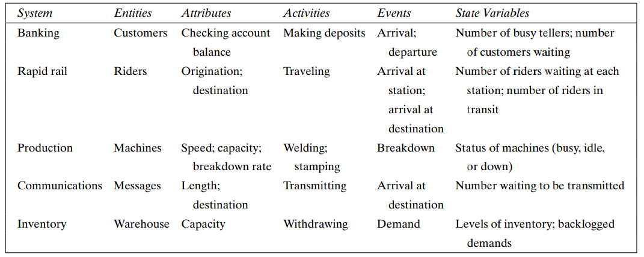
Example of System and its components…

Slide 24
System
System can be categorized into
Discrete System
Continuous System

Slide 25
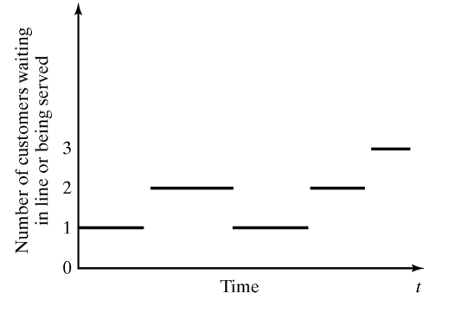
Discrete and Continues Systems
A discrete system is one in which the state variables change only at a discrete set of points in time : Bank example

Slide 26
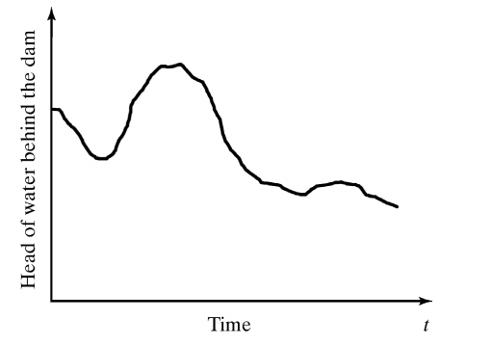
Discrete and Continues Systems (cont.)
A continues system is one in which the state variables change continuously over time: Head of water behind the dam

Slide 27
Model of a System (2011)
To study the system
it is sometimes possible to experiment
This is not always possible (bank, factory,…)
A new system may not yet exist
Model:
construct a conceptual framework that describes a system
A model is defined as a representation of system for the purpose of studying the system.
It is necessary to consider those accepts of systems that affect the problem under investigation (unnecessary details must remove)

Slide 28
Types of Models & System Models
Models can be classified → mathematical, physical & process.
A mathematical model uses symbolic notation and mathematical equations to represent a system.
A simulation model is a particular type of mathematical model of a system.
System Models may be further classified as:
STATIC OR DYNAMIC,
DETERMINISTIC OR STOCHASTIC,
DISCRETE OR CONTINUOUS

Slide 29
STATIC & DYNAMIC Models
A STATIC SIMULATION MODEL : represents a system at a particular point in time.
sometimes called a Monte Carlo simulation
An Architectural model of a house(Building) is static physical model
DYNAMIC SIMULATION MODELS: represent systems as they change over time.
The simulation of a bank from 9:00 A.M. to 4:00 P.M. is an example of a dynamic simulation
A wind tunnel is a dynamic physical model.

Slide 30
DETERMINISTIC & STOCHASTIC
Simulation models that contain no random variables are classified as deterministic .
Deterministic models have a known set of inputs which will result in a unique set of outputs.
A stochastic (sto·chas·tic) simulation model has one or more random variables as inputs.
Random inputs lead to random outputs.

Slide 31
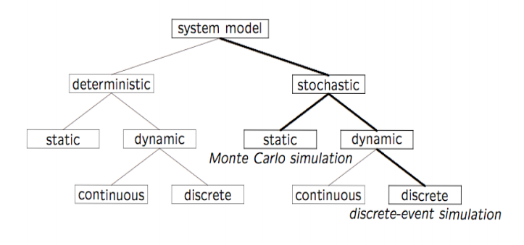
Types of System Models

Slide 32
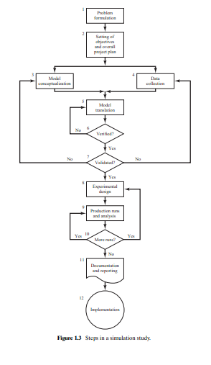
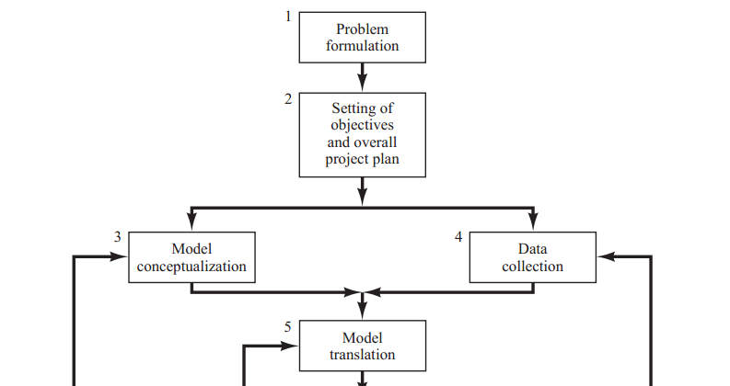
STEPS IN SIMULATION STUDY

Slide 33
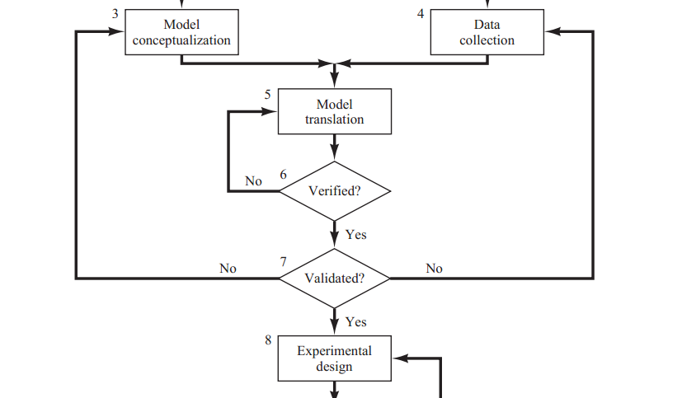

Slide 34
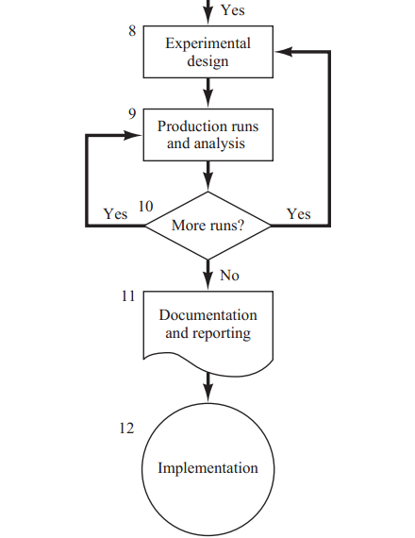

Slide 35
Steps in a Simulation Study
Problem Formulation
Setting of Objectives and Overall Project Plan
Model Conceptualization
Data Collection
Model Translation
Verification
Validation
Experimental Design
Production Run and Analysis
Documentation and Report
Implementation

Slide 36
Problem Formulation
the problem is clearly understood by the simulation analyst
the formulation is clearly understood by the client

Slide 37
Setting of Objectives and Overall Project Plan
determine the questions that are to be answered
determine the end-user
determine data requirements
determine hardware, software, & personnel requirements
prepare a time plan
cost plan and billing procedure

Slide 38
Model Conceptualization
abstract essential features
events, activities, entities, attributes, resources, variables, and their relationships
performance measures
data requirements
select correct level of details (assumptions)

Slide 39
Data Collection
Collect data for input analysis and validation
arrival rate, arrival process, service discipline, service rate , etc.
analysis of the data
determine the random variables
fit distribution functions

Slide 40
Model Translation
The model is translated into programming language. Choices range from general purpose languages such as fortran or simulation programs such as Arena.

Slide 41
Verification
Verify the model by checking if the program works properly. Use common sense. debugging the simulation software

Slide 42
Validation
Check if the system accurately represent the real system. comparison of model results with collected data from the real system

Slide 43
Experimental Design
type of output data analysis.
number of simulation runs
length of each run
variance reduction

Slide 44
Production Run & Analysis
statistical tests for significance and ranking
Point Estimation
Confidence-Interval Estimation
Actual running the simulation, collect and analyze the output.

Slide 45
Documentation & Report
Documentation consists of the written report and/or presentation
program documentation
allows future modifications
creates confidence
progress reports
frequent reports are suggested
alternative scenarios
performance measures or criteria used
results of experiments
Recommendations

Slide 46
Implementation
Implement the study in real system

